Slide 1
Secure Data Hiding in images using steganography
CAPSTONE PROJECT
Presented By:
Student Name : Suhan Aktar Mazumder
College Name & Department : Gurucharan College, Computer Science

Slide 2
OUTLINE
Problem Statement
Technology used
Wow factor
End users
Result
Conclusion
Git-hub Link
Future scope

Slide 3
Problem Statement
Digital communication does not have secure means of concealing sensitive information. Conventional encryption techniques tend to draw attention, and data becomes susceptible to interception.
This project uses image steganography with Python and OpenCV, enabling users to hide secret messages within images without changing their appearance. This method offers a hidden means of sending confidential information securely.

Slide 4
Technology used
Programming Language: Python
Libraries:
1. OpenCV → For image processing and pixel manipulation.
2. OS → For file handling and system commands.
Platform: Works on Windows, Linux, and macOS.
Tools:
1. GitHub → For version control and project hosting.
2. VS Code / PyCharm → For writing and debugging the code.

Slide 5
Wow factors
Prevention of Data Loss – This script ensures that messages do not exceed the image’s capacity, avoiding data corruption or program failure.
Optimized Pixel Manipulation – The modified version correctly handles row and column limits, preventing out-of-bounds errors.

Slide 6
End users
Cybersecurity Enthusiasts
Students
Developers & Researchers
Educators & Trainers

Slide 7
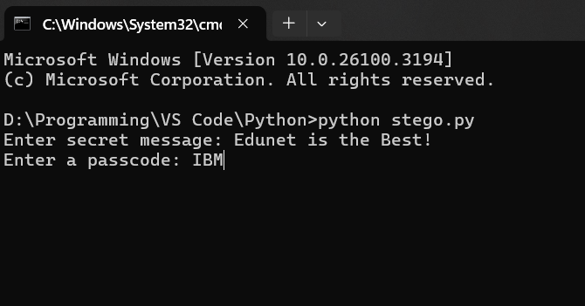
Results (1/3)
1. Running the script and providing the secret message & passcode:

Slide 8
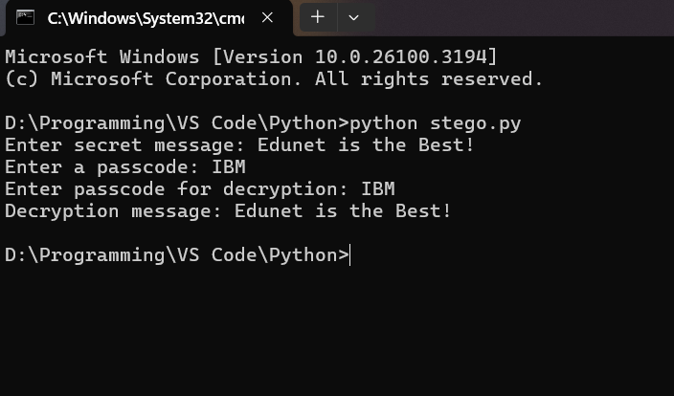
Results (2/3)
2. Output (In CMD):

Slide 9
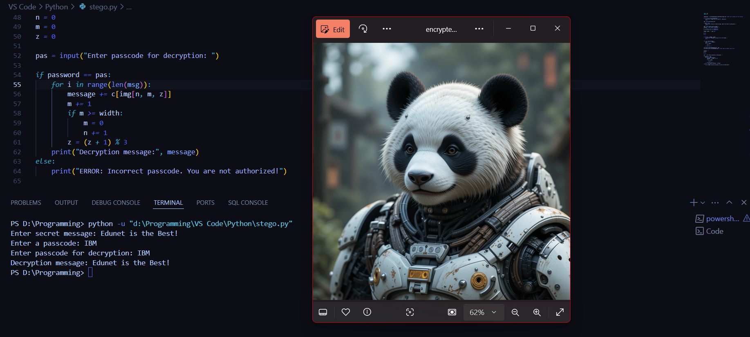
Results (2/3)
3. Output (In VS Code):

Slide 10
Conclusion
This project effectively solves the problem of hiding messages in images securely through steganography. In contrast to conventional encryption techniques that draw attention, this method facilitates hidden communication without apparent image alteration.
This project demonstrates the effectiveness of image-based data hiding as a method of secure communication, thus making it beneficial for students, developers, and security enthusiasts. Future improvements can make security even better by including encryption and advanced encoding techniques.

Slide 11
GitHub Link
https://github.com/quadvecta/Stegno-Project.git

Slide 12
Future scope(optional)
Support for Multiple Image Formats – Expand compatibility beyond .jpg to formats like .png, .bmp, and .tiff.
Increased Data Capacity – Optimize encoding techniques to store longer messages without noticeable image distortion.
Detection Prevention Techniques – Implement advanced steganography methods to make detection by steganalysis tools more difficult.
Mobile and Web-Based Version – Convert the script into a mobile or web application for easier accessibility and real-world use.

Slide 13
THANK YOU

